Slide 1
Cloud Computing and Big Data Realtime Big Data
Oxford University
Software Engineering Programme
July 2020

Slide 2
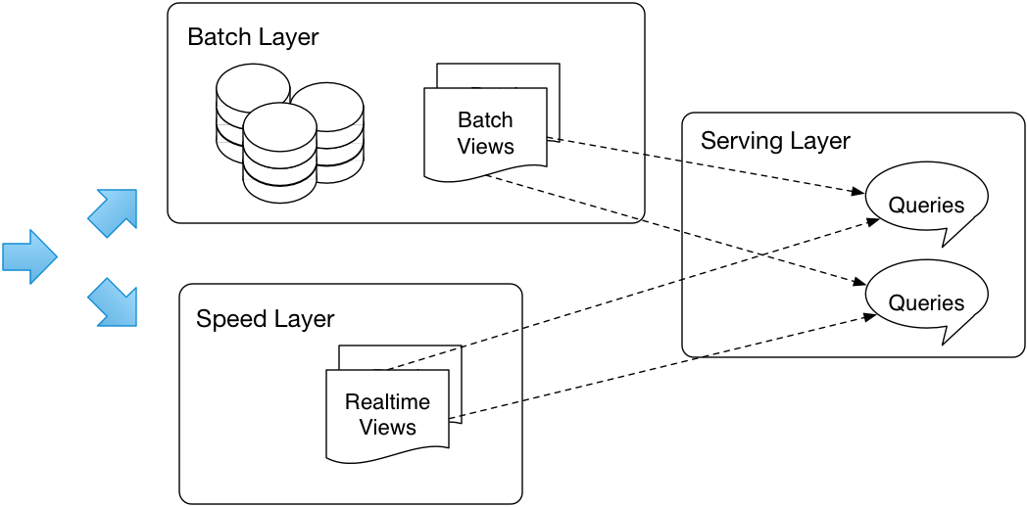
Recap on the Lambda Architecture

Slide 3
Streaming
Continuous data flow
“Unbounded streams of data”
Usually uses a message distribution system
JMS
Apache Kafka
MQTT
Etc
An unbounded set of events with time
<t1, E1>, <t2, E2>, ….., <tn, En>, ....

Slide 4
Stream processing categorization
Simple event processing
Working on an event at a time
e.g. filter out all events where the wind speed > 50 mph
Event stream processing
Time-based processing of a single stream of events
Average wind speed over the last hour compared to the average over the last day
Complex Event Processing
Correlation of events across different streams
Emergency calls correlated with wind speed in real time

Slide 5



Comparing Databases with Real-Time systems
 | Database Applications | Event-driven Applications
Query Paradigm | Ad-hoc queries or requests | Continuous standing queries
Latency | Seconds, hours, days | Milliseconds or less
Data Rate | Hundreds of events/sec | Tens of thousands of events/sec or more
Event
output stream
request
input stream
response

Slide 6
Lambda Architecture

Slide 7
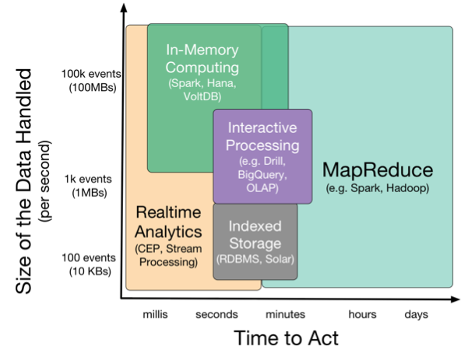

Slide 8
Approaches to Streaming
Pure streaming
Each event is processed as it comes in
Micro-batch
Small batches of events are processed
Typically trades flexibility for performance
Shared nothing
You can process events on any system in the cluster
Stateful / Partitioned
The event must be processed on a system that has the correct state in memory

Slide 9
Data distribution
You need to get the events to the processing systems

Slide 10
Event Driven Architecture
Event Consumer
Event Producer
Event
Event Consumer

Slide 11
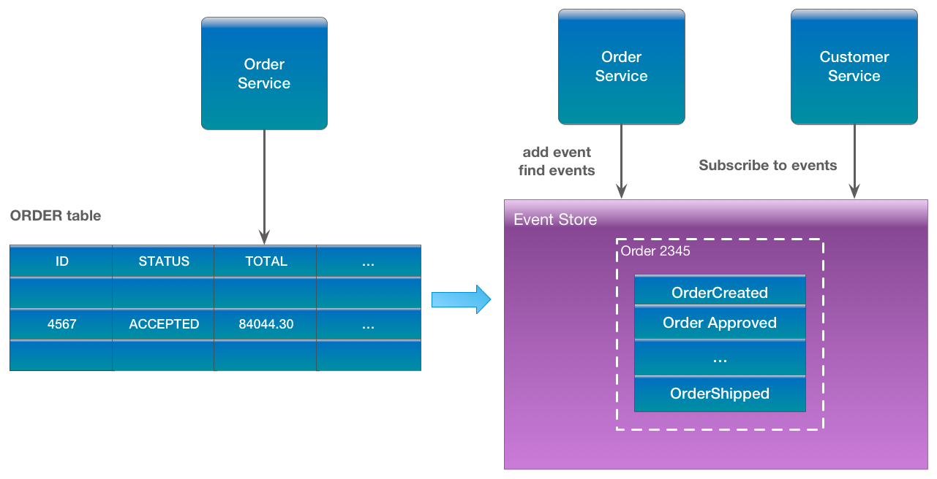
Event Sourcing
https://eventuate.io/whyeventsourcing.html

Slide 12
MQTT
Very lightweight binary protocol
2-byte overhead
Widely used in IoT scenarios
Pub-sub only until MQTT5
QoS levels
Fire and forget QoS0
At least once QoS1
Exactly once QoS2

Slide 13
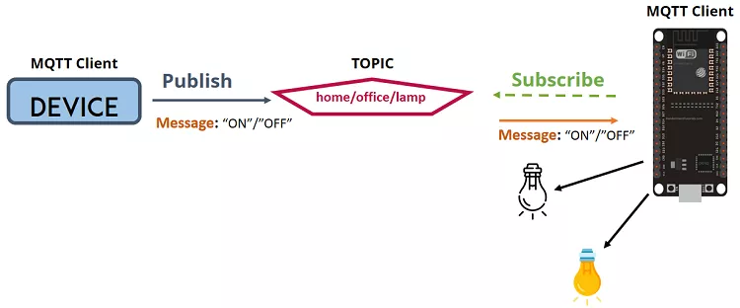
MQTT

Slide 14
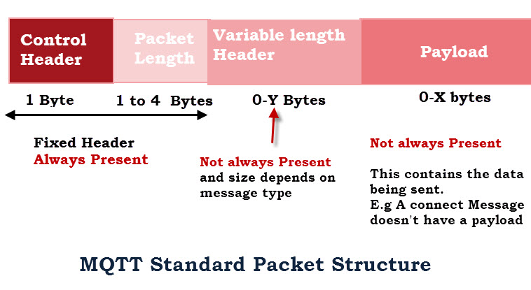
MQTT Packets http://www.steves-internet-guide.com/mqtt-protocol-messages-overview/

Slide 15
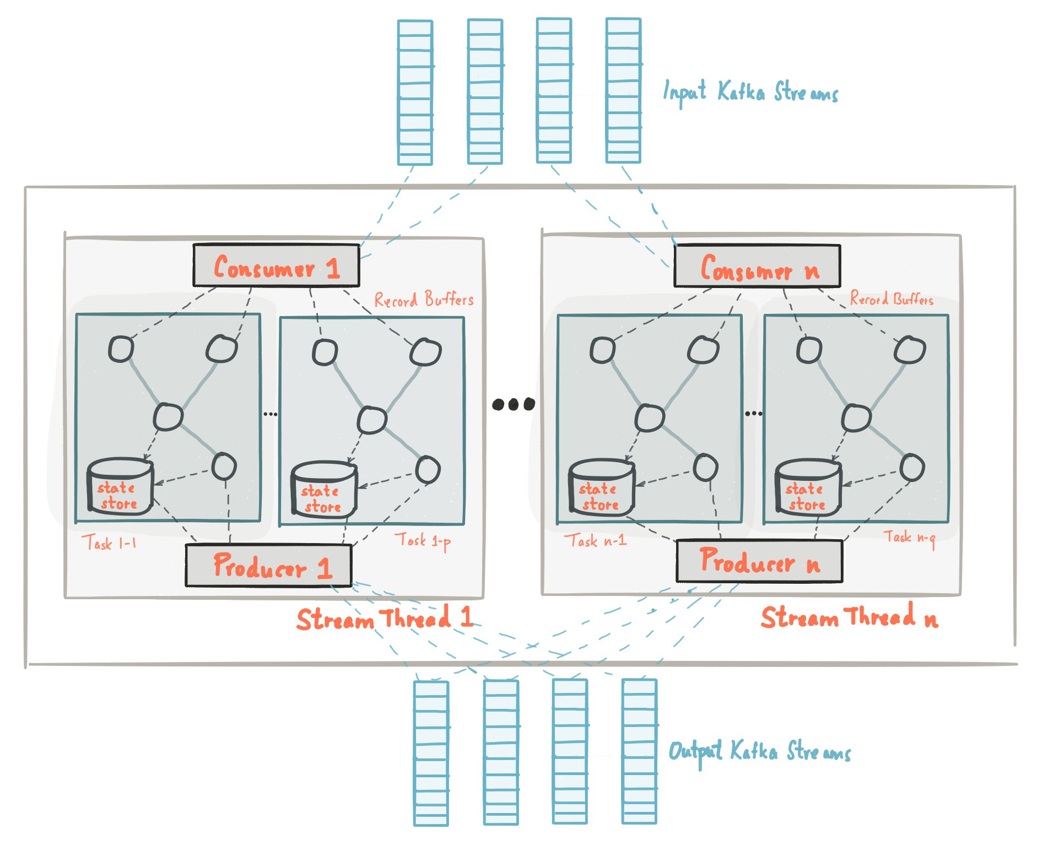
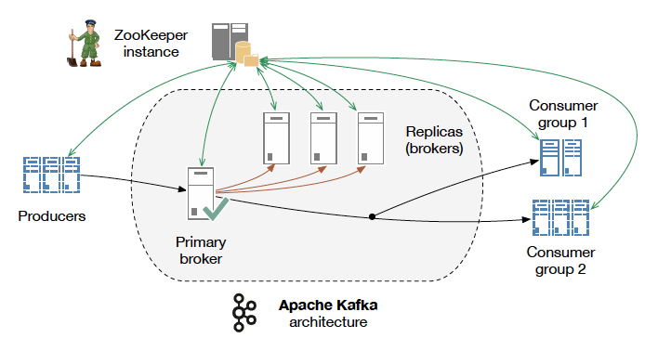
Apache Kafka

Slide 16
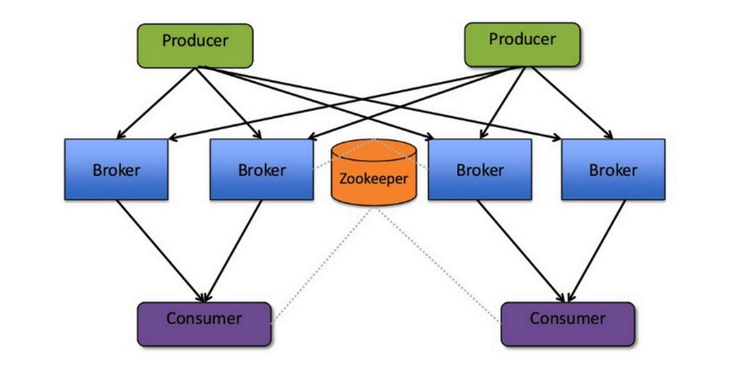
Apache Kafka
Source: http://www.slideshare.net/charmalloc/

Slide 17
Kafka
Applying “big data” approaches to messaging:
Partitioning
Multiple brokers
Elastically scalable
Supports clusters of co-ordinated consumers
Automatic re-election of leaders

Slide 18
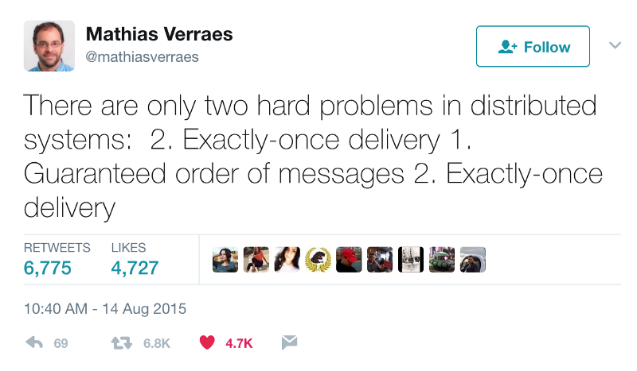
Kafka exactly-once semantics

Slide 19
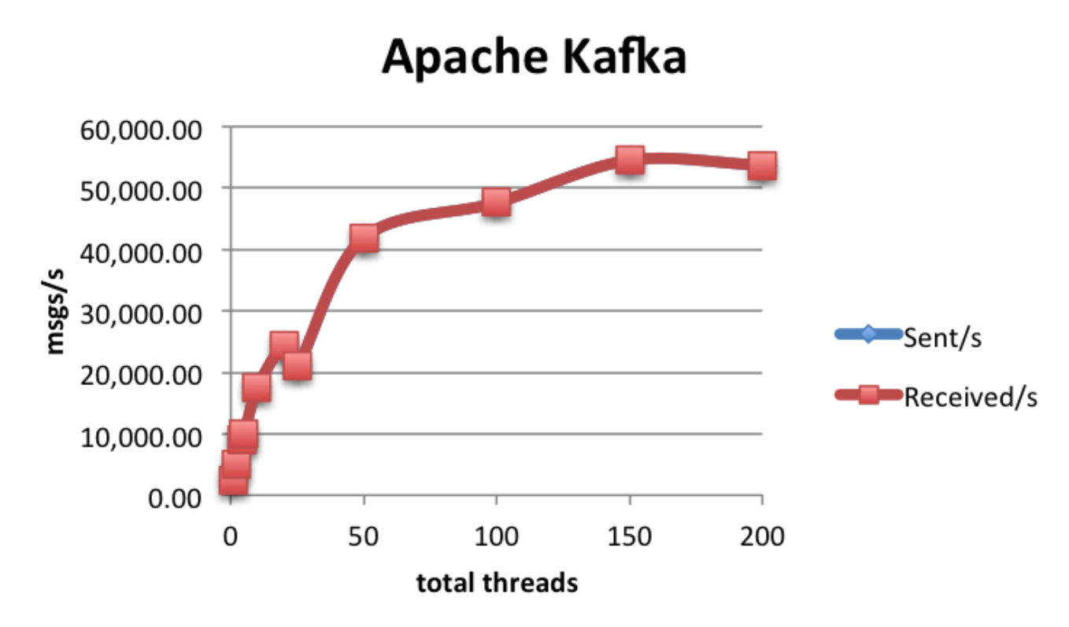
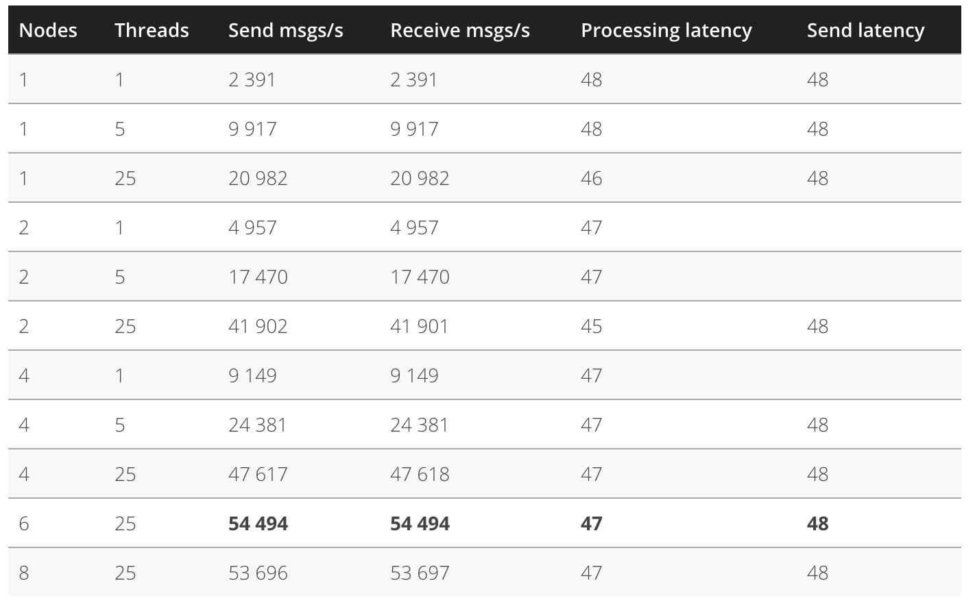
Kafka Performance

Slide 20
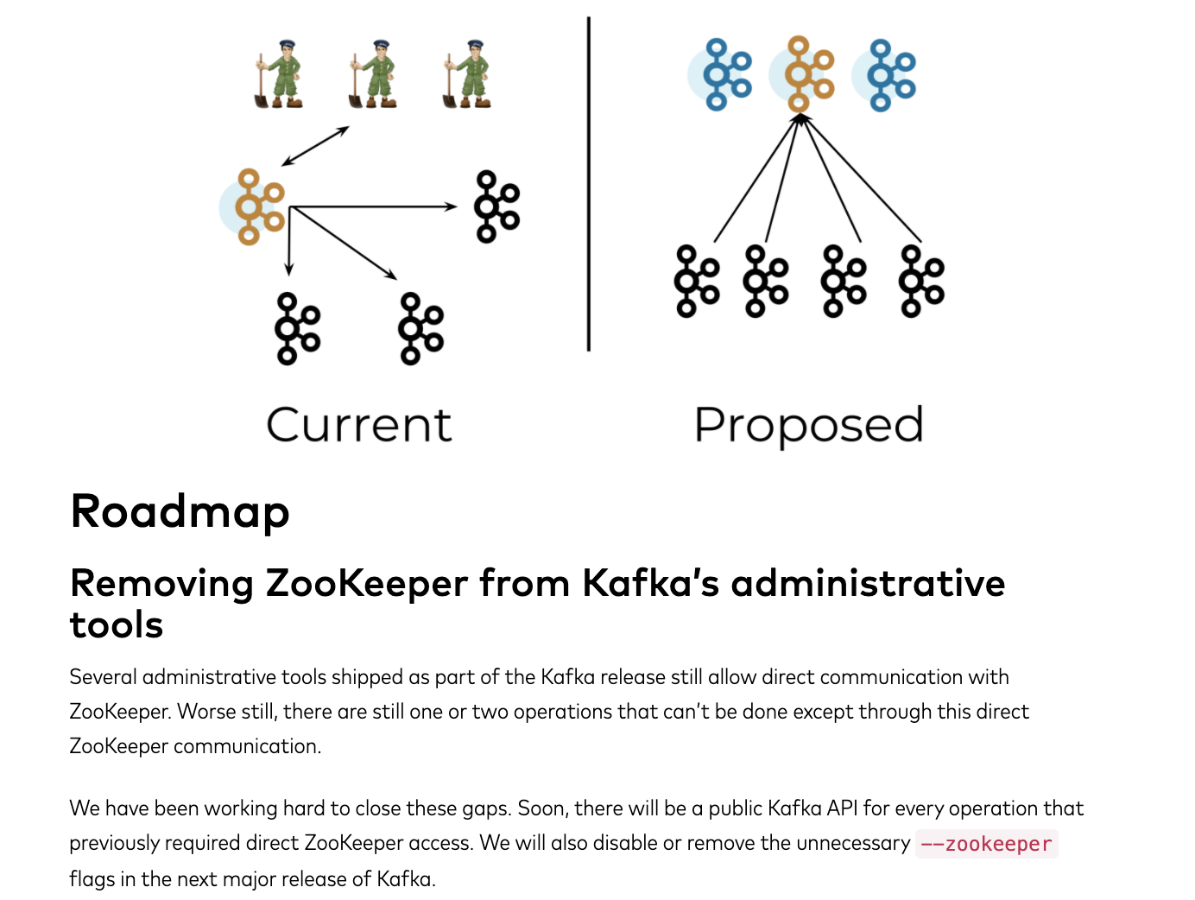

Slide 21
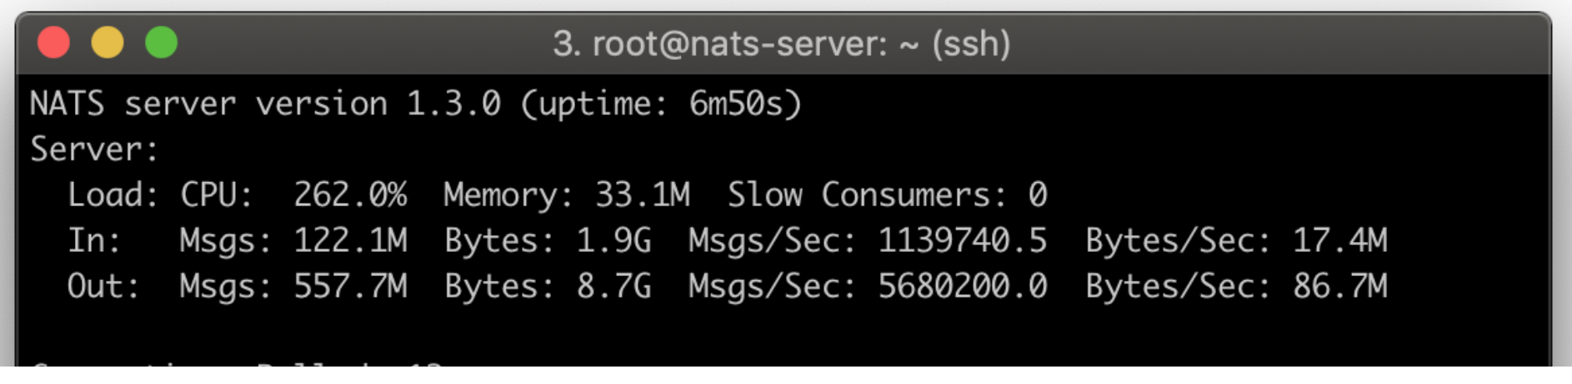
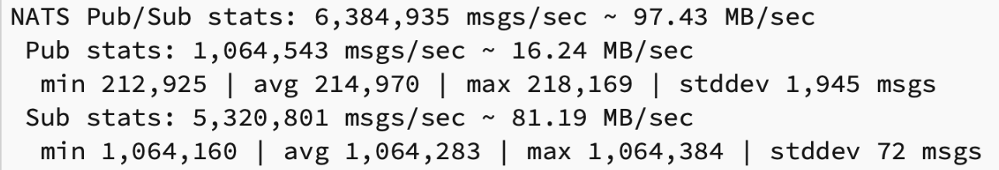
NATS
3Mb Docker image
Minimum HA deployment is 2 servers (automatic hot-cold)

Slide 22
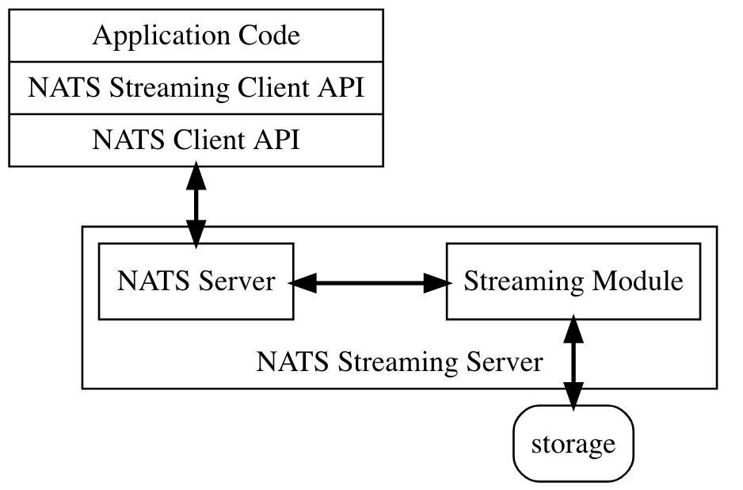
NATS Streaming

Slide 23
NATS Streaming
At least once delivery
Publisher rate limiting
Subscriber rate limiting
Message Replay
Durable Subscriptions

Slide 24
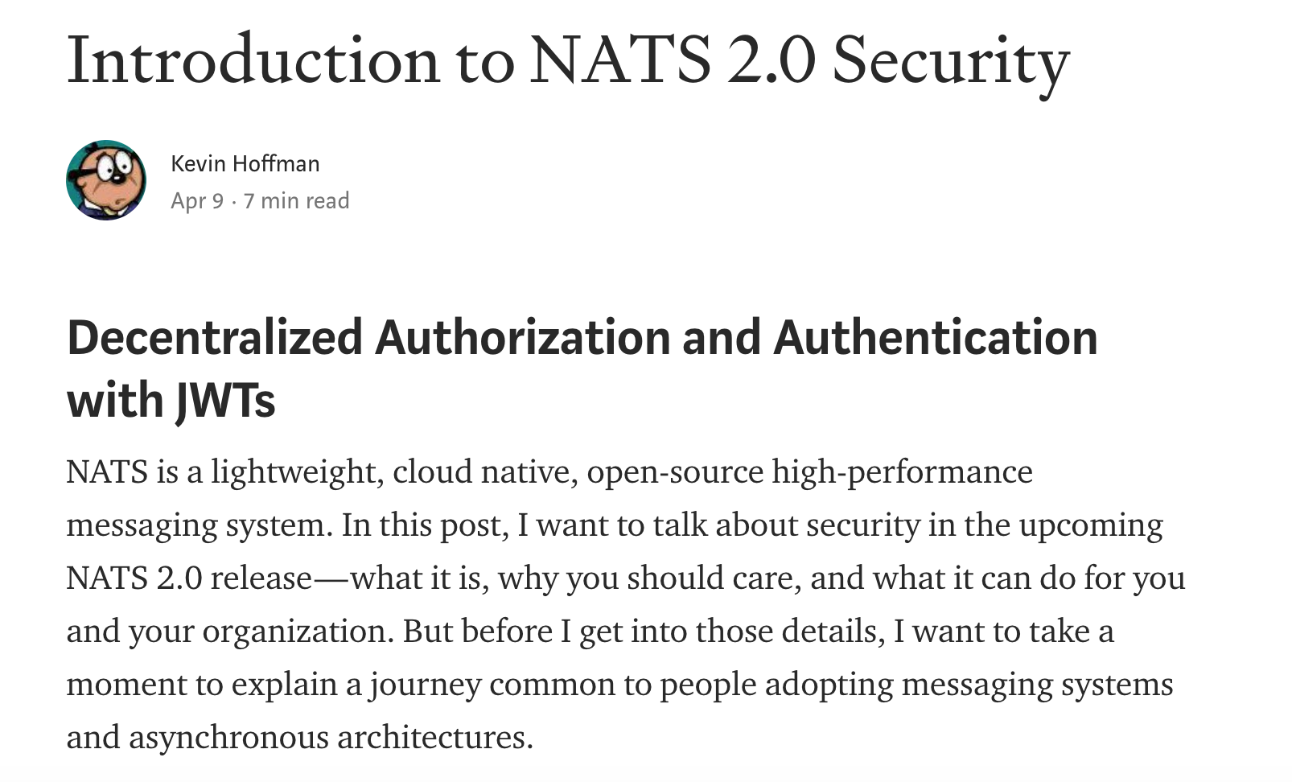
NATS security model

Slide 25
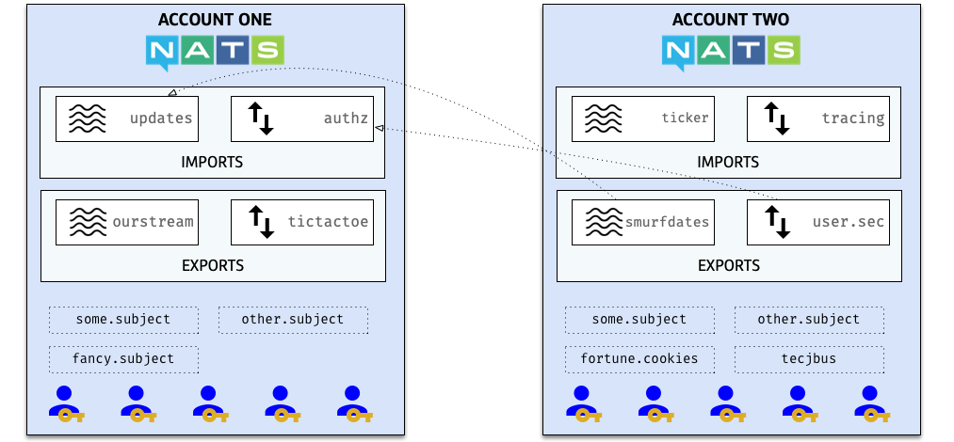
NATS security model

Slide 26
Processing the data

Slide 27

Apache Storm
Spout
Bolt
Bolt
Spout
Bolt
Note: another DAG

Slide 28
Apache Storm
Originally developed by BackType
Nathan Marz
Acquired by Twitter
Open Sourced and then donated to Apache
Became a top level project in 2014
http://storm.apache.org

Slide 29
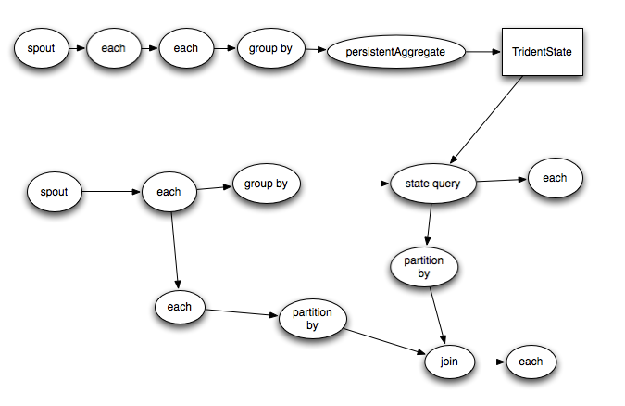
Apache Storm Trident (micro-batch)

Slide 30
Storm vs Spark Streaming
“Classic” Storm has no counterpart in Spark
Spouts and Bolts
Event by event processing
Trident and Streaming both offer micro-batch models
More performant but less flexible
Storm is more flexible for pure streaming systems
Spark offers a much more unified programming model for Batch and Streaming

Slide 31
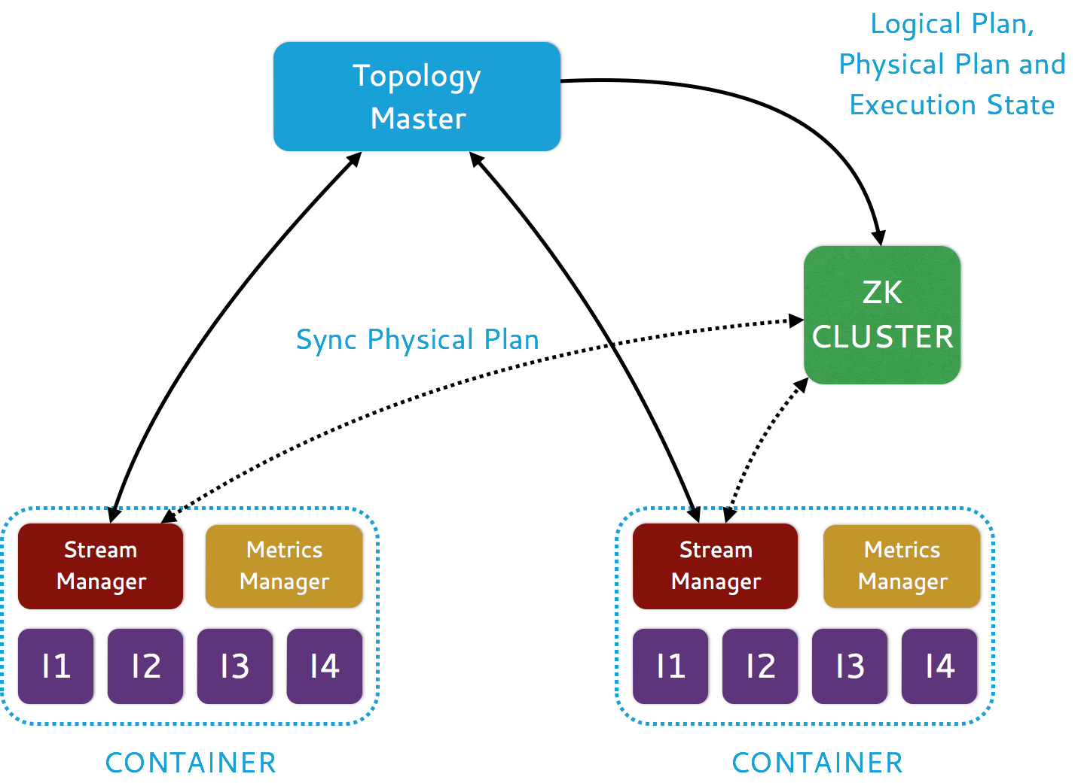
Heron

Slide 32
Heron: Key Features
Fully API compatible with Apache Storm
Task isolation
Developer productivity
Ease of manageability
Use of mainstream languages C++/Java/Python

Slide 33
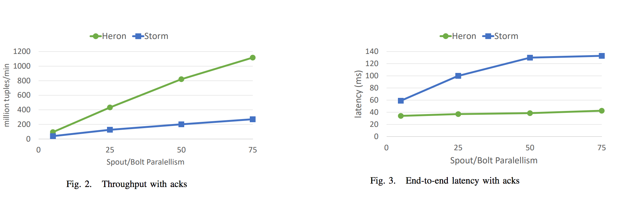
Heron
In production at Twitter for >2 years
Going into production at Microsoft, WeChat
Donation to CNCF

Slide 34
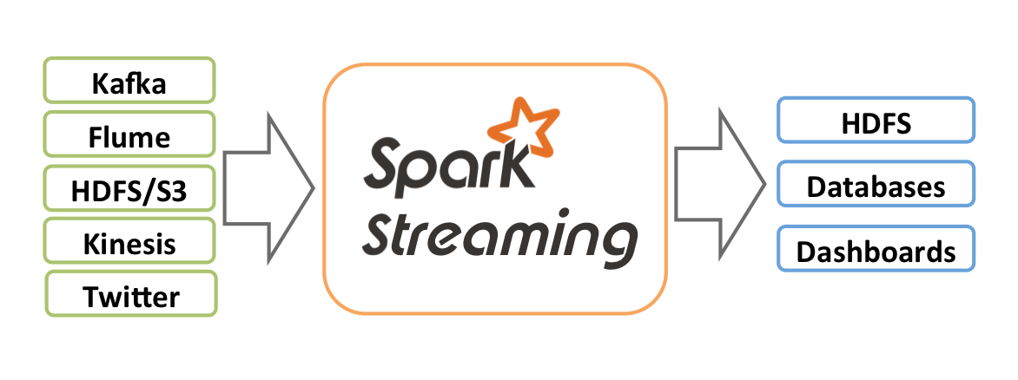
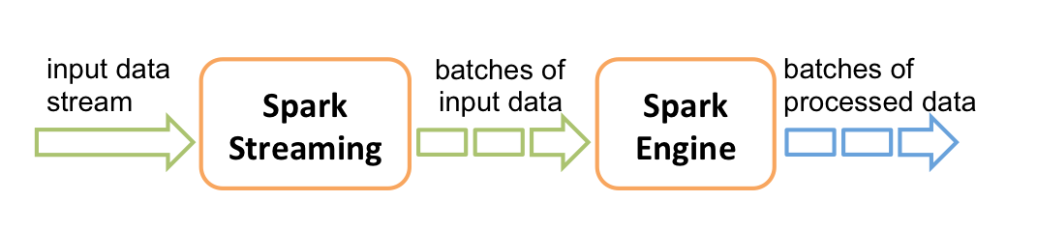
Apache Spark Streaming

Slide 35
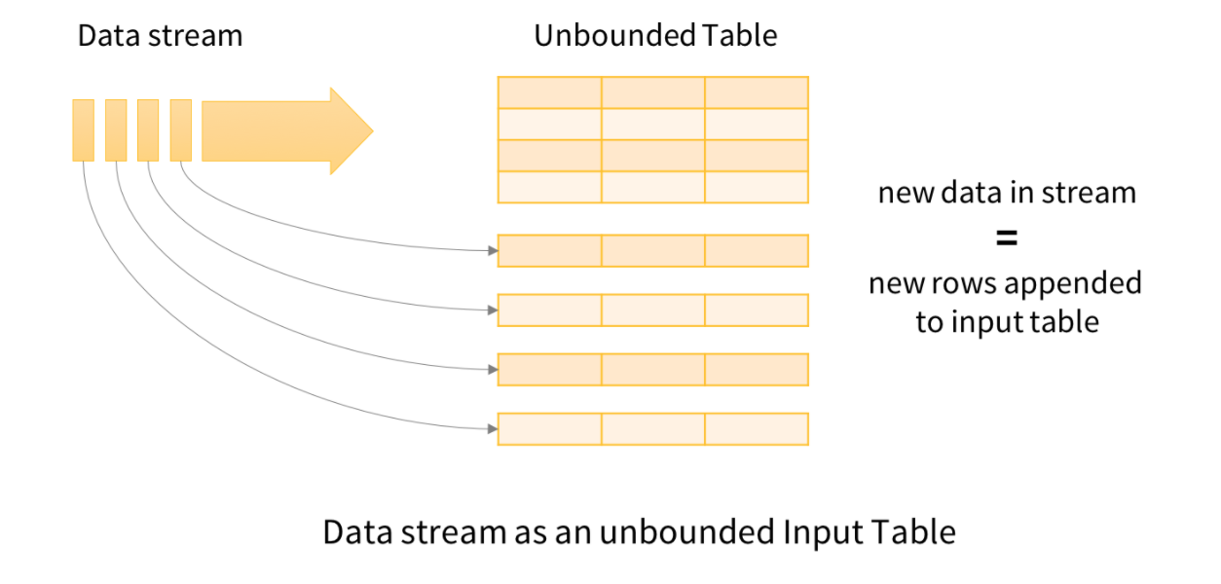
Structured Streams in Spark
Since Spark 2.0, there is a much better approach

Slide 36
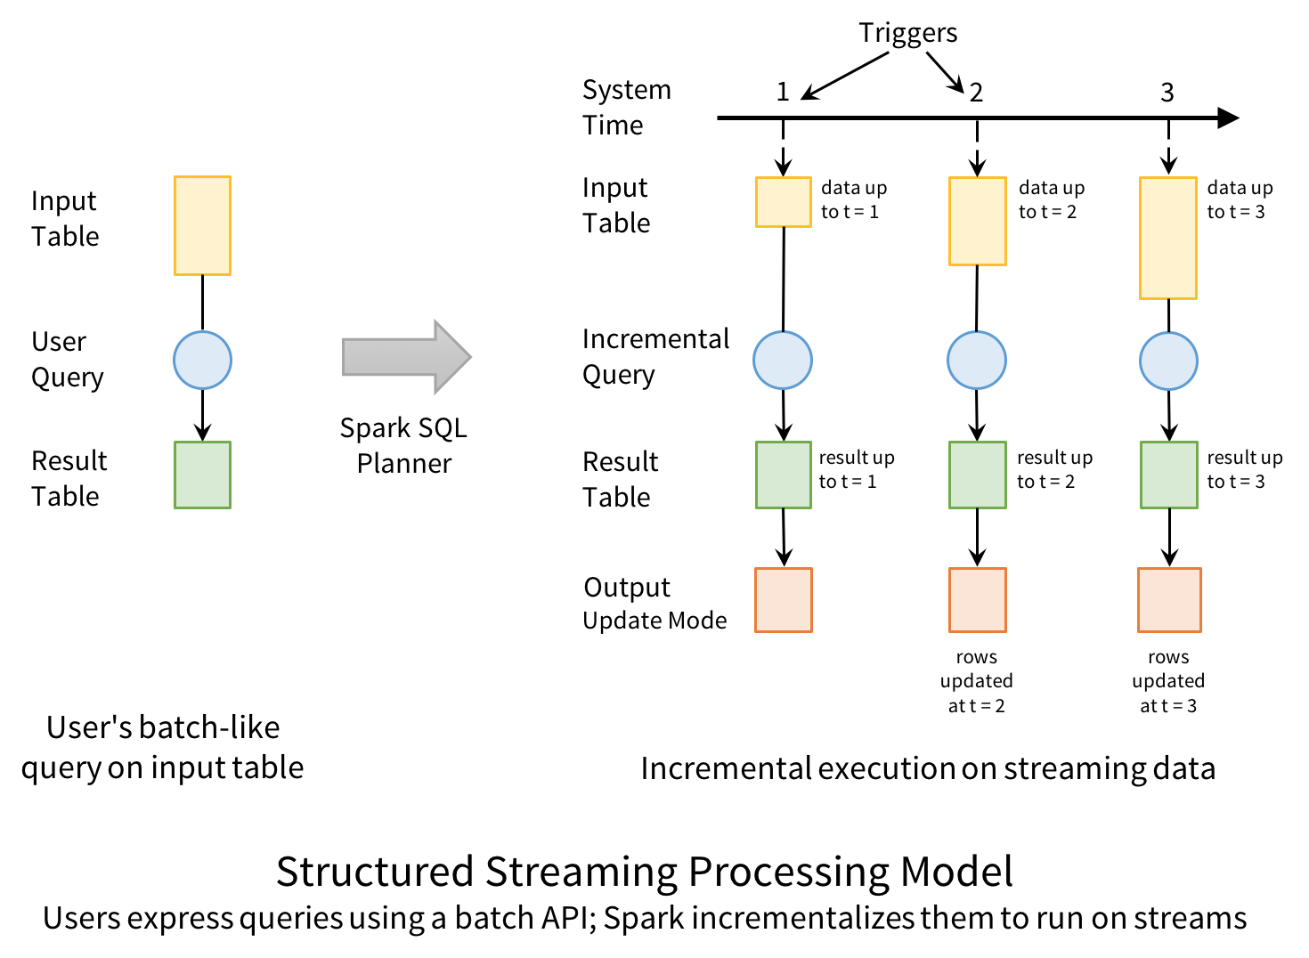

Slide 37
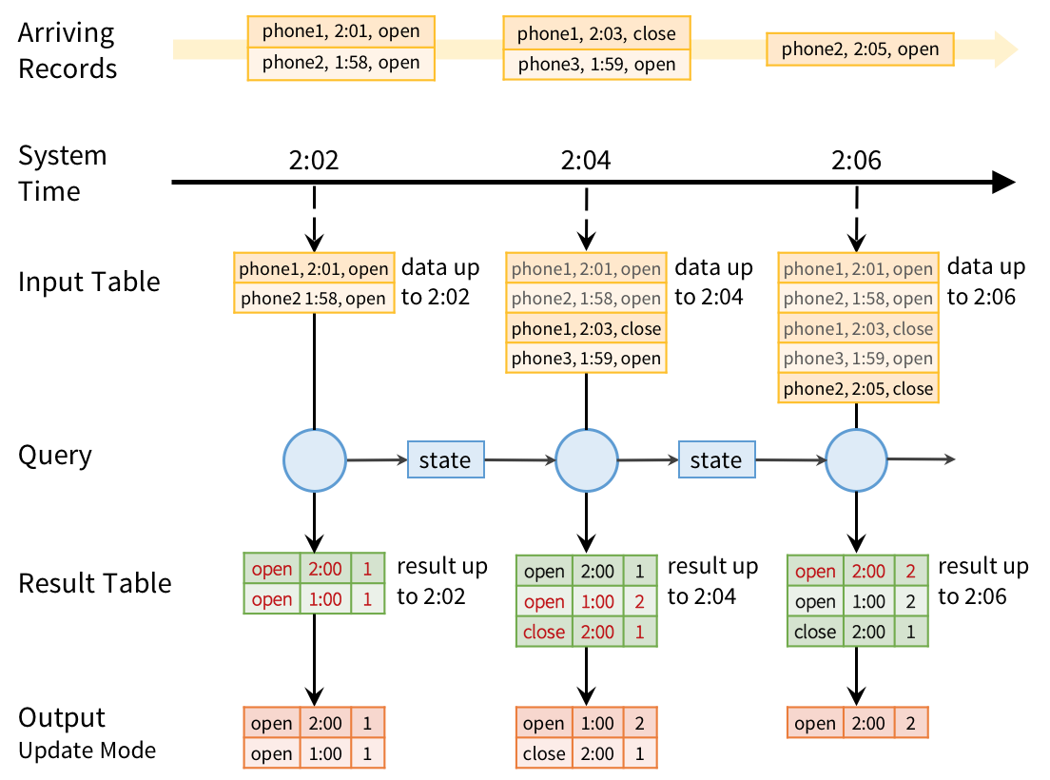

Slide 38
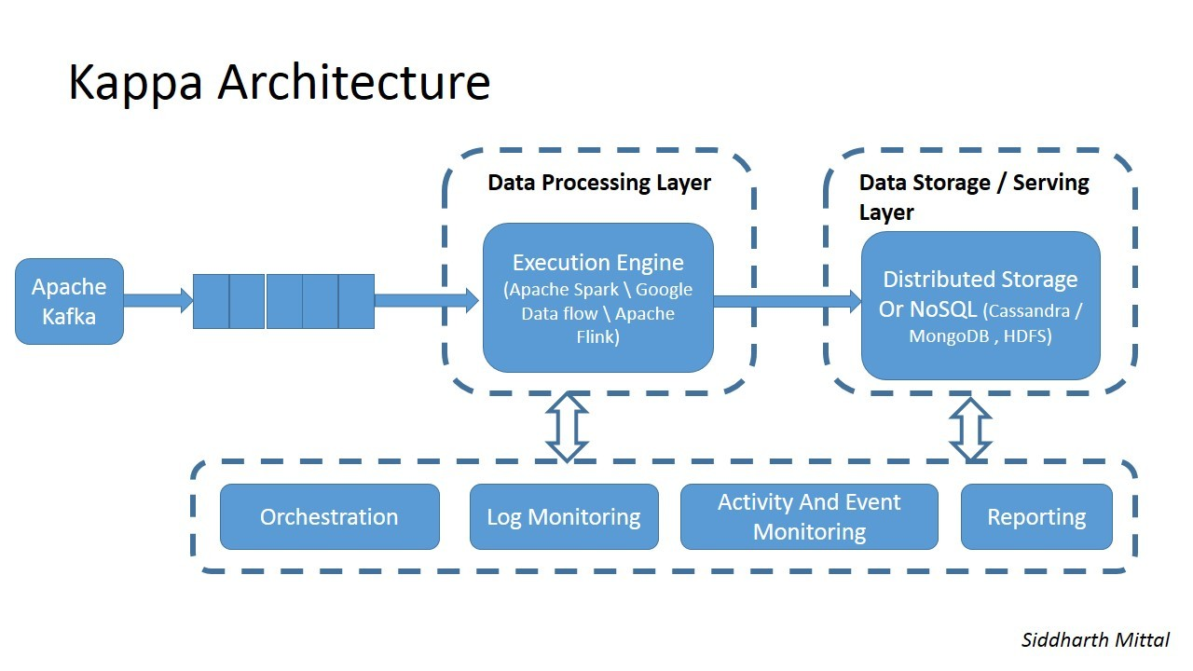
Kappa Architecture
https://jonboulineau.me/blog/architecture/kappa-architecture

Slide 39
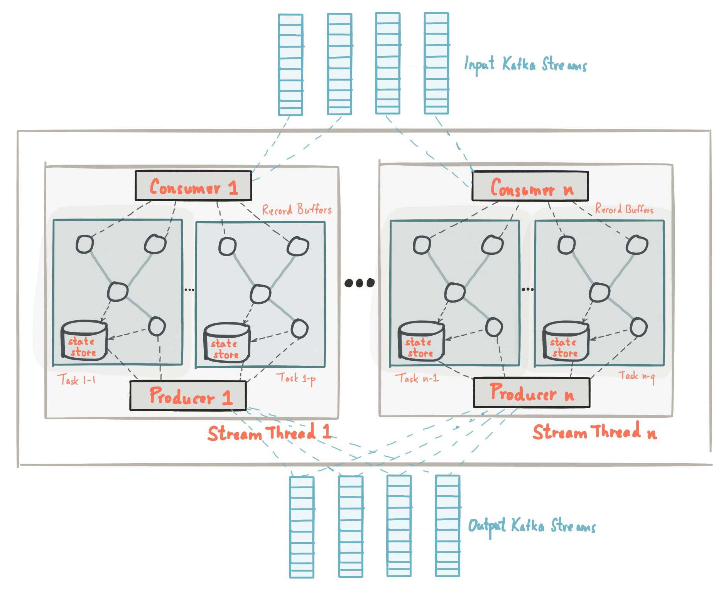
Kafka Streams

Slide 40
Kafka Streams
Event-at-a-time processing (not microbatch) with millisecond latency
Stateful processing including distributed joins and aggregations
A convenient DSL
Windowing with out-of-order data using a DataFlow-like model
Distributed processing and fault-tolerance with fast failover
Reprocessing capabilities so you can recalculate output when your code changes
No-downtime rolling deployments

Slide 41
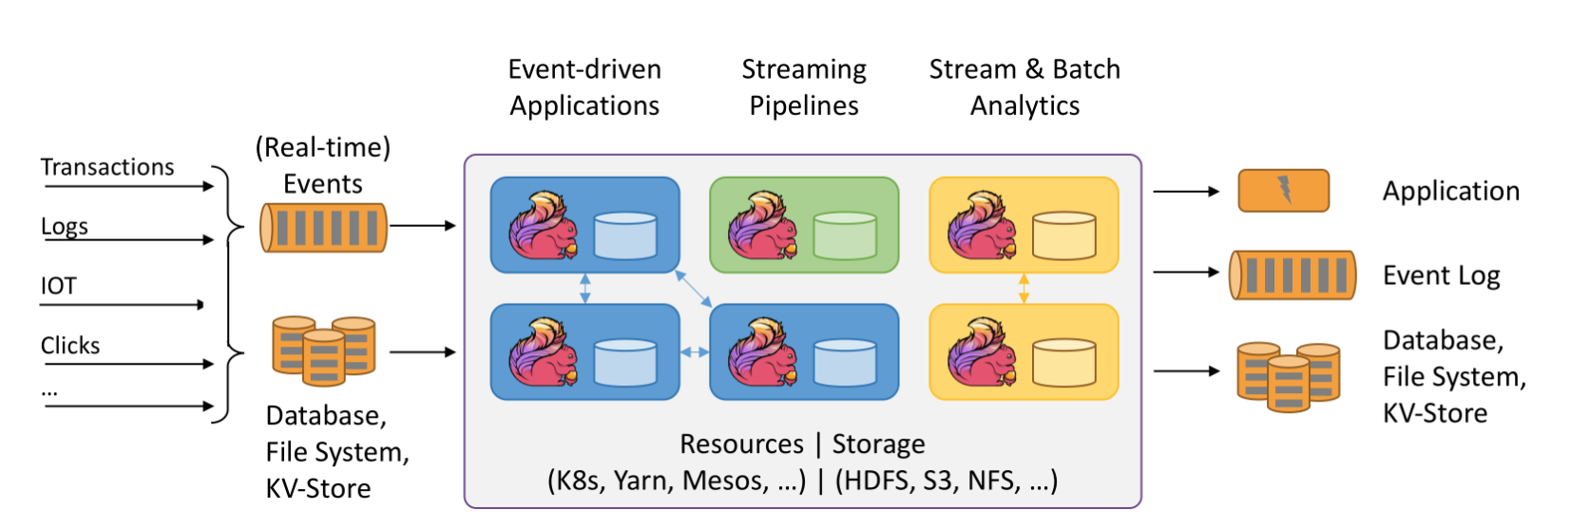
Apache Flink

Slide 42
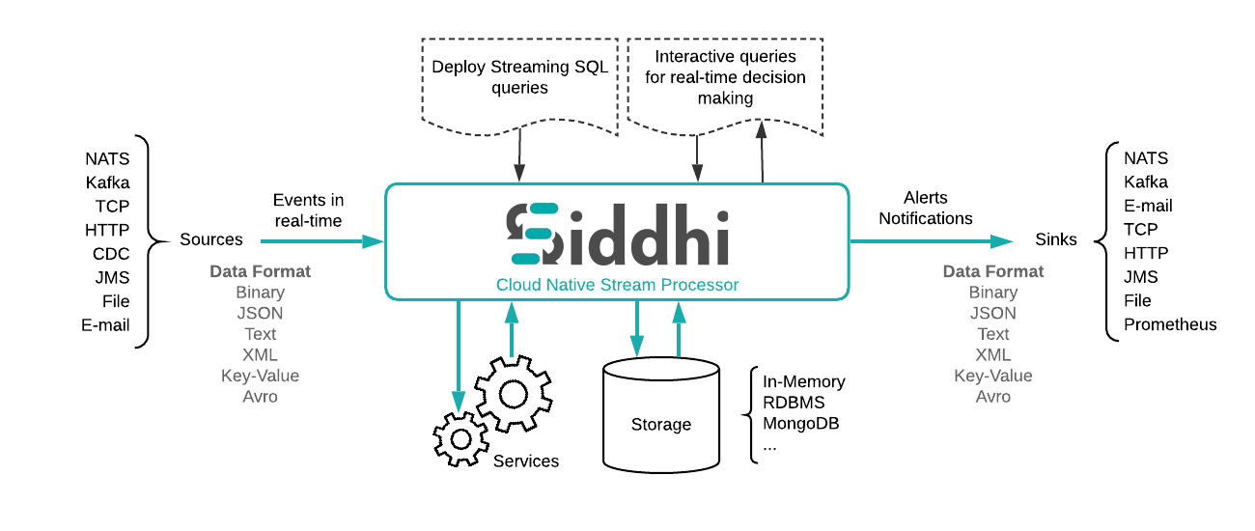
siddhi.io

Slide 43
Siddhi
A stateful query model
SQL-like language for querying streams of data
Extended with windows
Time, Event count, batches
Partitioned
Based on data in the events
Pattern matching
A then B then C within window

Slide 44
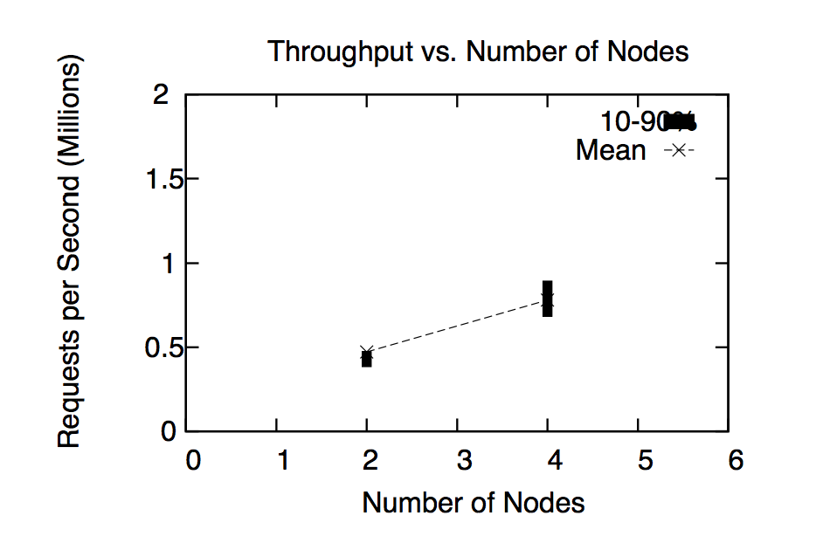
Siddhi
Apache Licensed Open Source on Github
https://github.com/wso2/siddhi/
Pluggable into Storm, Spark and Kafka Streams
Supports millions of events/sec
http://freo.me/DEBS_Siddhi

Slide 45
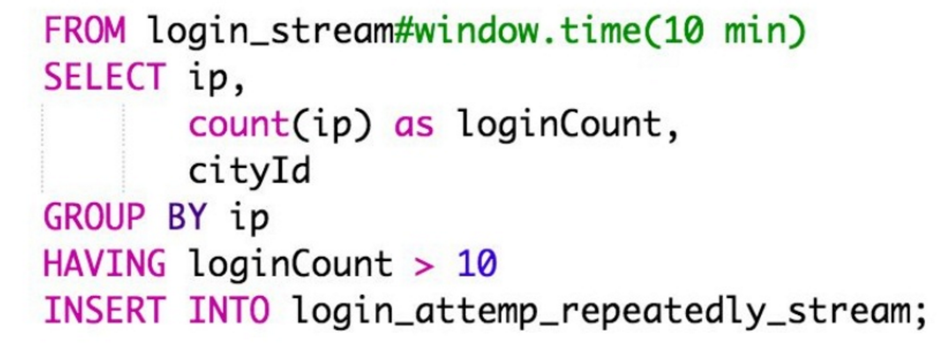
SiddhiQL

Slide 46
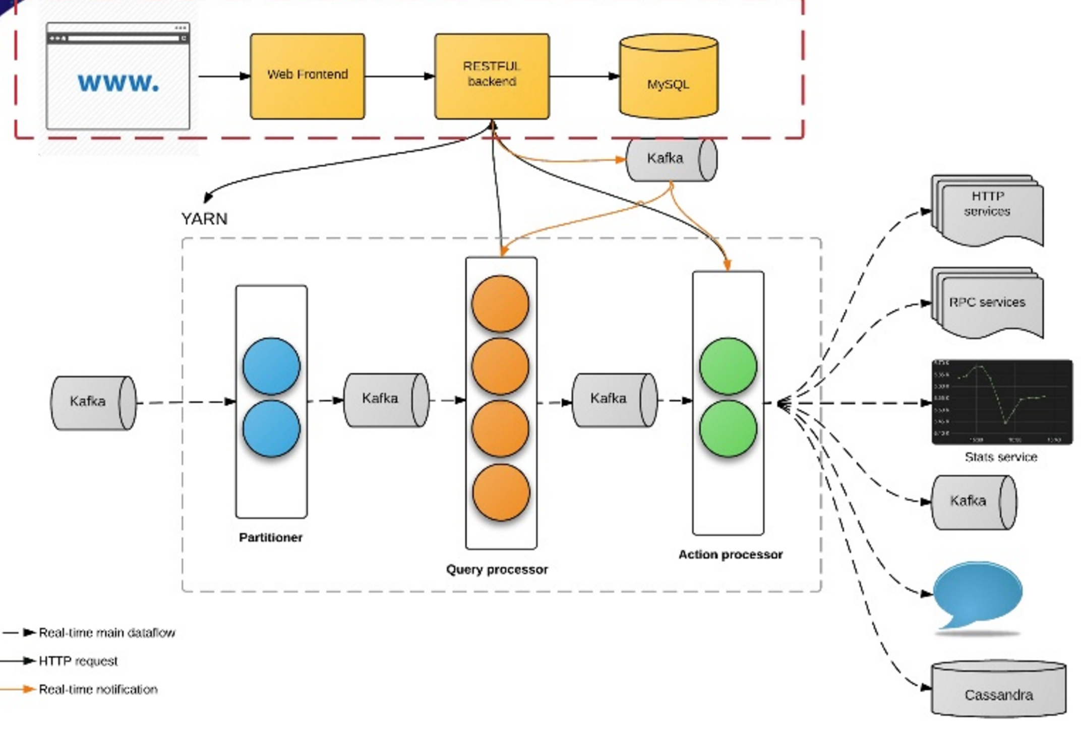
Siddhi at Uber

Slide 47
Siddhi at Uber
100+ production apps
30 billion messages / day
Fraud, anomaly detection
Marketing, promotion
Monitoring, feedback
Real time analytics and visualization
https://freo.me/siddhi-uber

Slide 48
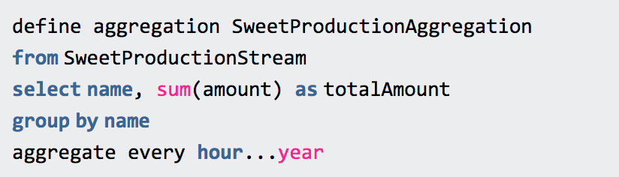
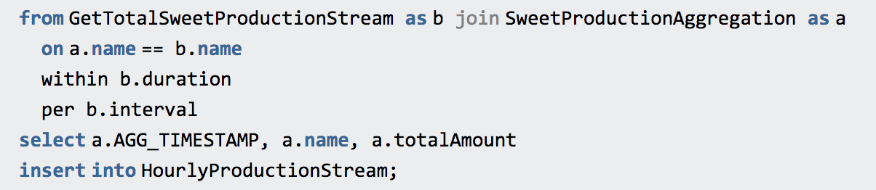
Long-running aggregation

Slide 49
Summary
Realtime processing is hard
Requires large memory and state
The lambda architecture splits the problem into batch and realtime challenges
Multiple approaches:
Pure Streaming
Micro-batch
Stateful Stream Processing

Slide 50
Questions?

